Slide 1
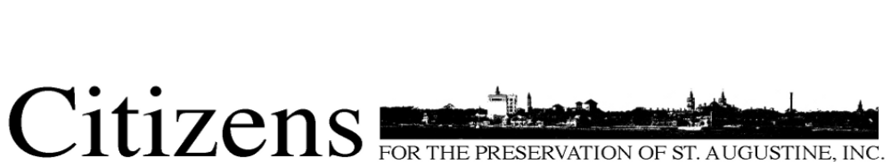
Top Ten Threatened Sites
May 2017
Each of the sites on this list have various threats. Some more urgent than others. Some are vacant and others are occupied. The purpose of the Top 10 Threatened List is to highlight buildings that have been determined as irreplaceable to the history and character of a neighborhood, or the City as a whole.
These houses hold stories of the lives of the people who lived in them and helped make St. Augustine the city it is today. The style and architecture of each contributes to the character of their neighborhood.
Their loss is the loss of a piece of the multi-layered history that creates St. Augustine unique appeal. The maintenance, preservation, and restoration of these sites is important to the fabric of St. Augustine.

Slide 2
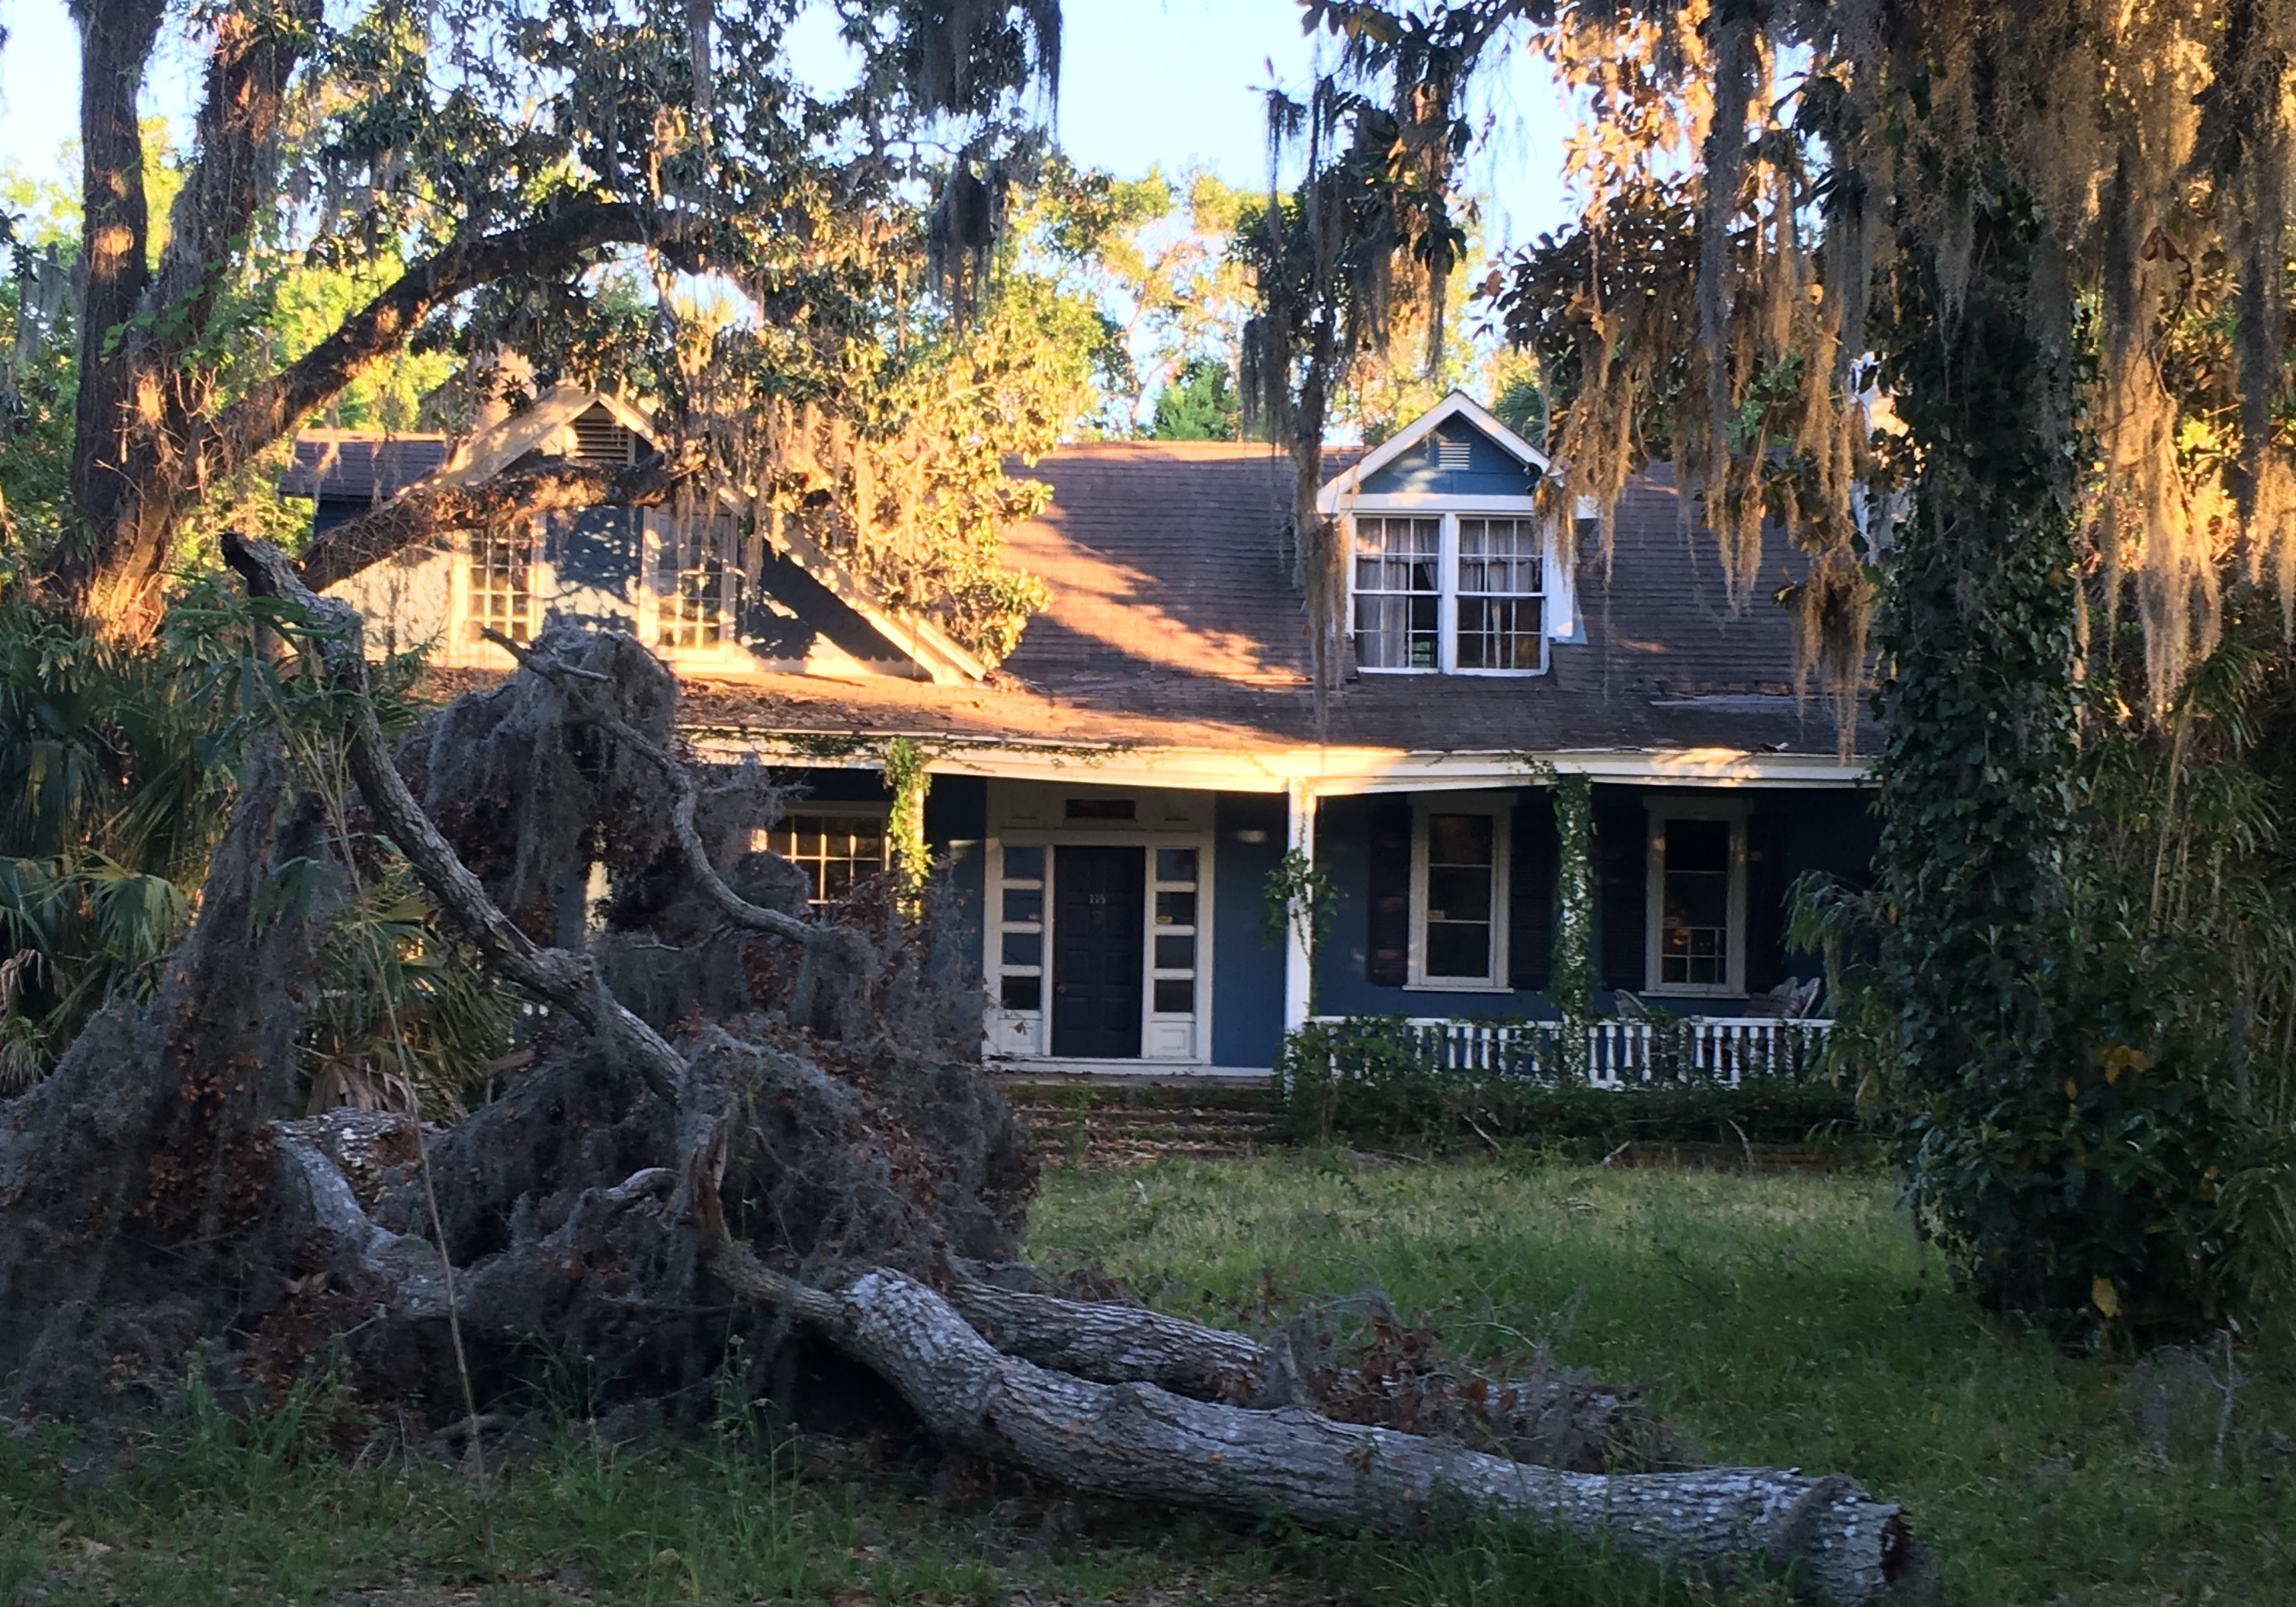
Top Ten Threatened Sites
This house sits on land granted to Juan Bousquet and Gaspar Papy, separately, in the late 1770’s. They planted one of the first commercial orange groves in Florida on the site. “Yallaha” the Seminole word for “Orange,” came from owner Peter Skenandoah Smith in 1838, a developer of North City. The house, built in 1845 by Peter & Rose Dumas is the oldest surviving building in that portion of the City and one of the few surviving pre-Civil War buildings. Dumas held political offices in the City, County and State and was related to the famous writer, Alexander Dumas.
Michael Spades, a successful dry goods merchant, bought the house in 1893 and remodeled it into “one of the most beautiful homes in St. Augustine,” where his wife and daughter entertained much of the winter society. Other owners include A.J. Marble, a founder of the Art Institute of Chicago; and J.C. Heartt of a prominent Troy, NY family. His sister, Francis Heartt Raub, acquired the house on his death in the 1920’s.
Charles F. Usina purchased the house in 1954 and sold it in 1955 to William Forrester, a local contractor, who remodeled the house several times. The house was listed in excellent condition in 1978.
115 Bridge St
Yallaha Plantation

Slide 3
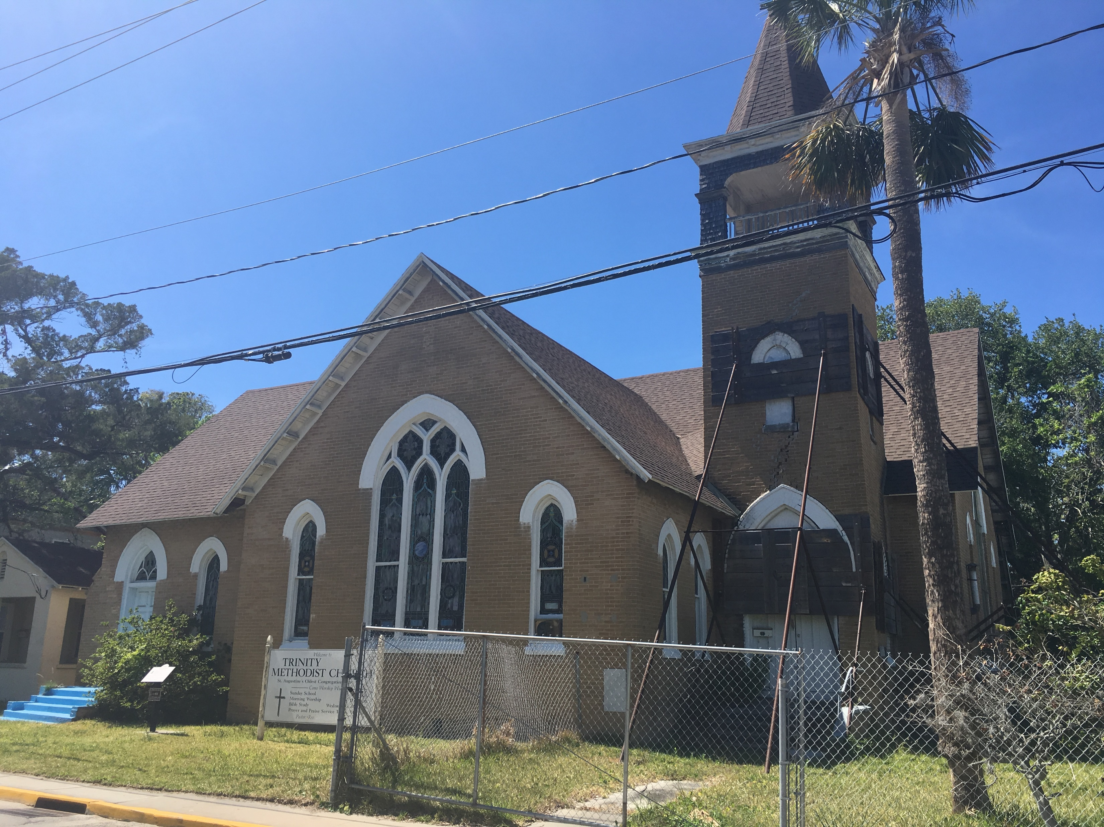
Top Ten Threatened Sites
Originally situated on St. George Street, the Trinity United Methodist Church was a gathering place for worshipers of all races. The onset of the Civil War saw the white male portion of the congregation depart for the battlefield. This left the congregation predominantly Black.
The Church was reorganized in 1870 under the Rev. JC Howard. The building was turned over to the Black Congregation. In 1905, the MEC asked for the property to be returned. The Blacks refused and the entire property was sold, the proceeds divided equally. These were used to build a new Church, completed in 1913.
This Church on Bridge Street is an example of the architecture and material used in institutional religious buildings in the early 1900’s. The Ancient City Baptist Church, slightly older, is another example of this.
This Church is significant due to the use of its stairs by Martin Luther King, Jr. to address the Black community during the civil rights turmoil of 1963-1964.
84 Bridge St
Trinity United Methodist

Slide 4
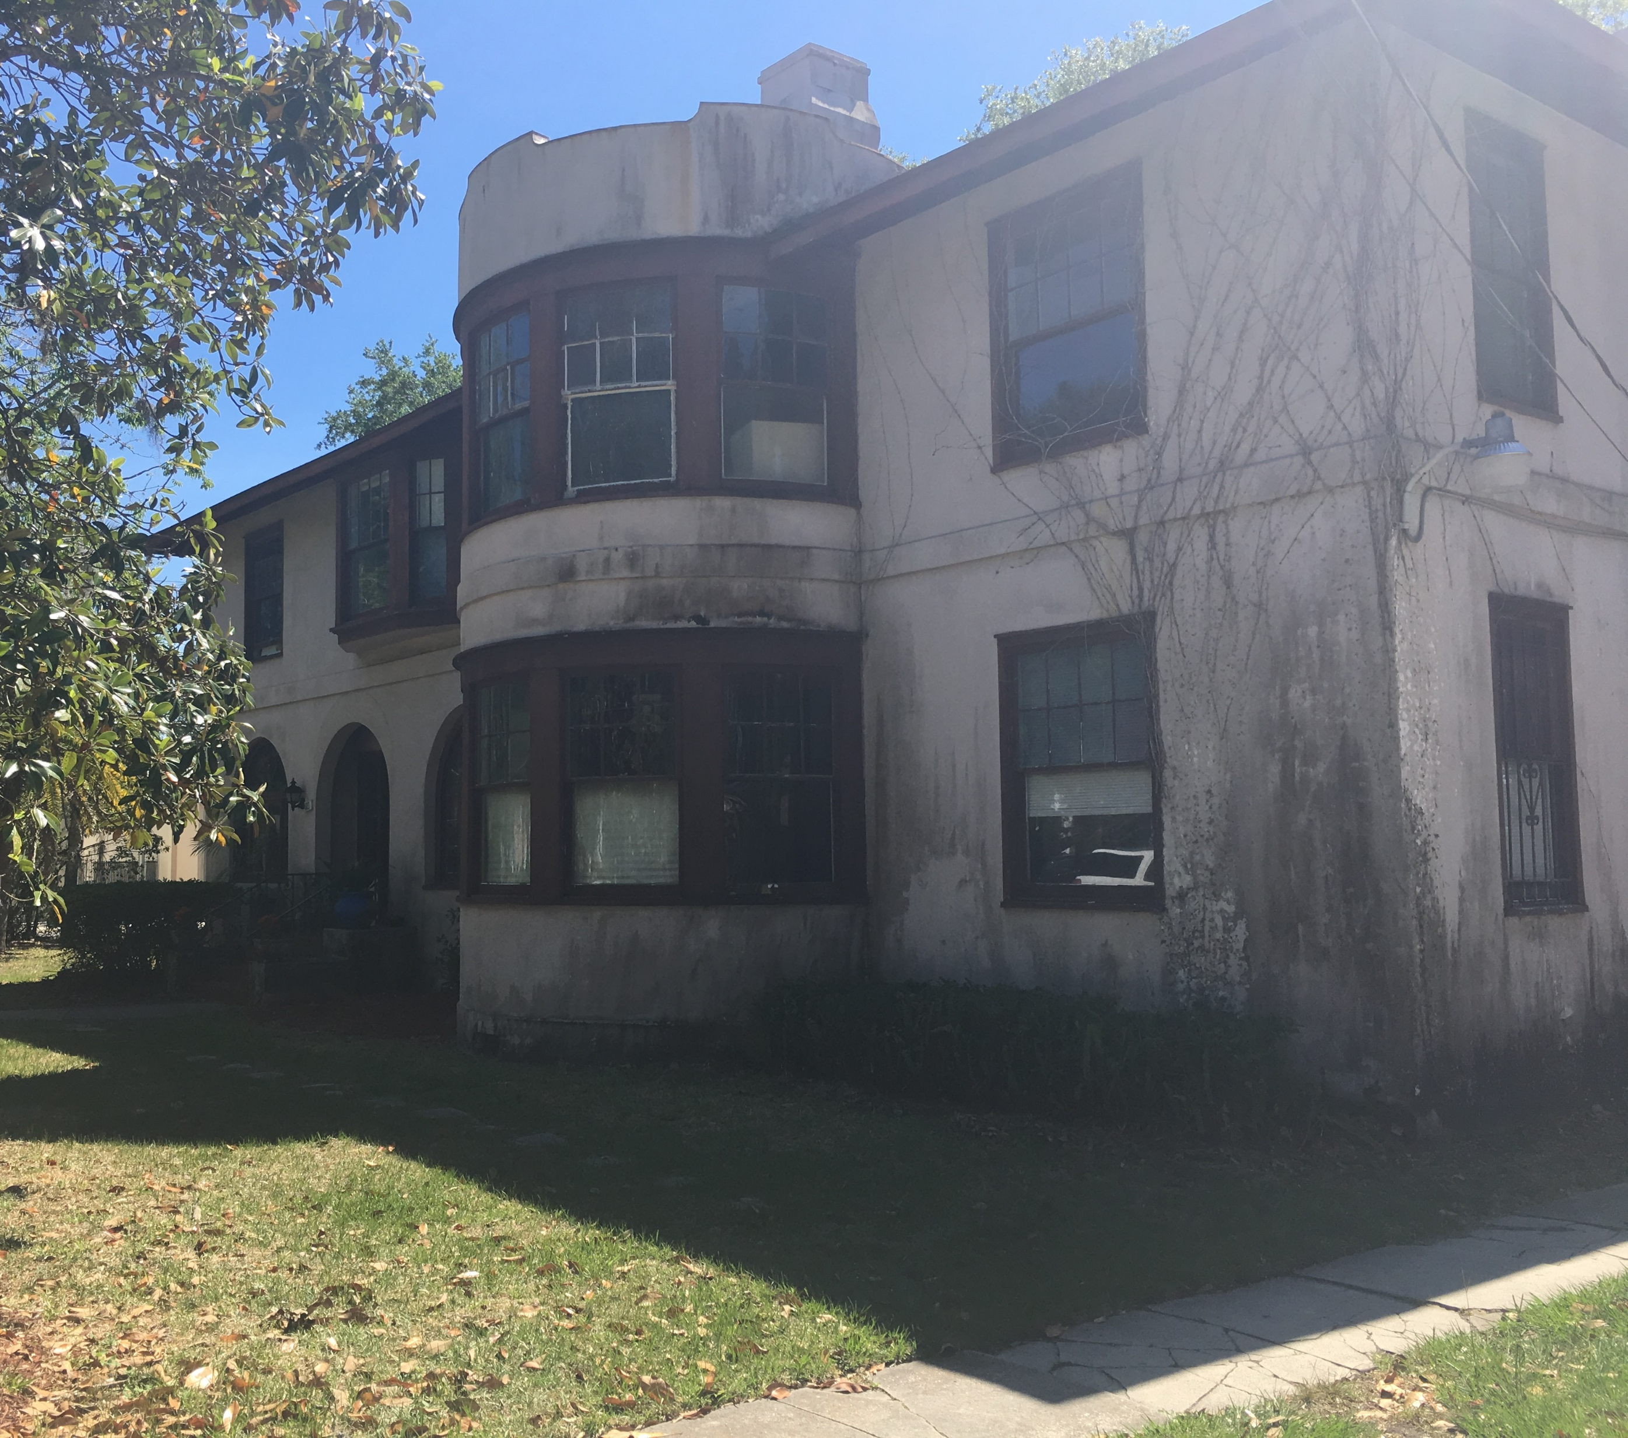
Top Ten Threatened Sites
108 King St
“Casa Mia” Rice-Lawton Home
The winter home of Mr. and Mrs. Thomas A. Lawton. He, a prominent banker in Rhode Island; she, a descendent of the Mayflower Pilgrims John and Priscilla Alden. The couple purchased the lot on King St. in 1905 and built a house described by the “Tatler” as in keeping with the great hotels nearby and with the few remaining old Spanish houses. It was also described as a “modern home.” The Lawtons sold the house to LG Willaume in 1913. Mr. Lawton would die the following year and his wife followed in 1927.
The unknown designer of the house introduced a form of architecture new to Florida, and the United States. It featured elements typical of traditional Spanish architecture such as arches and a round tower, but its clean lines and sparse ornamentation give it a modern appearance.
The current owners, the Rice family, purchased the house around 1940 and continue to own it. They have ceased regular use of the house. Loss of this home would permanently alter the character of the Model Land Company neighborhood.

Slide 5
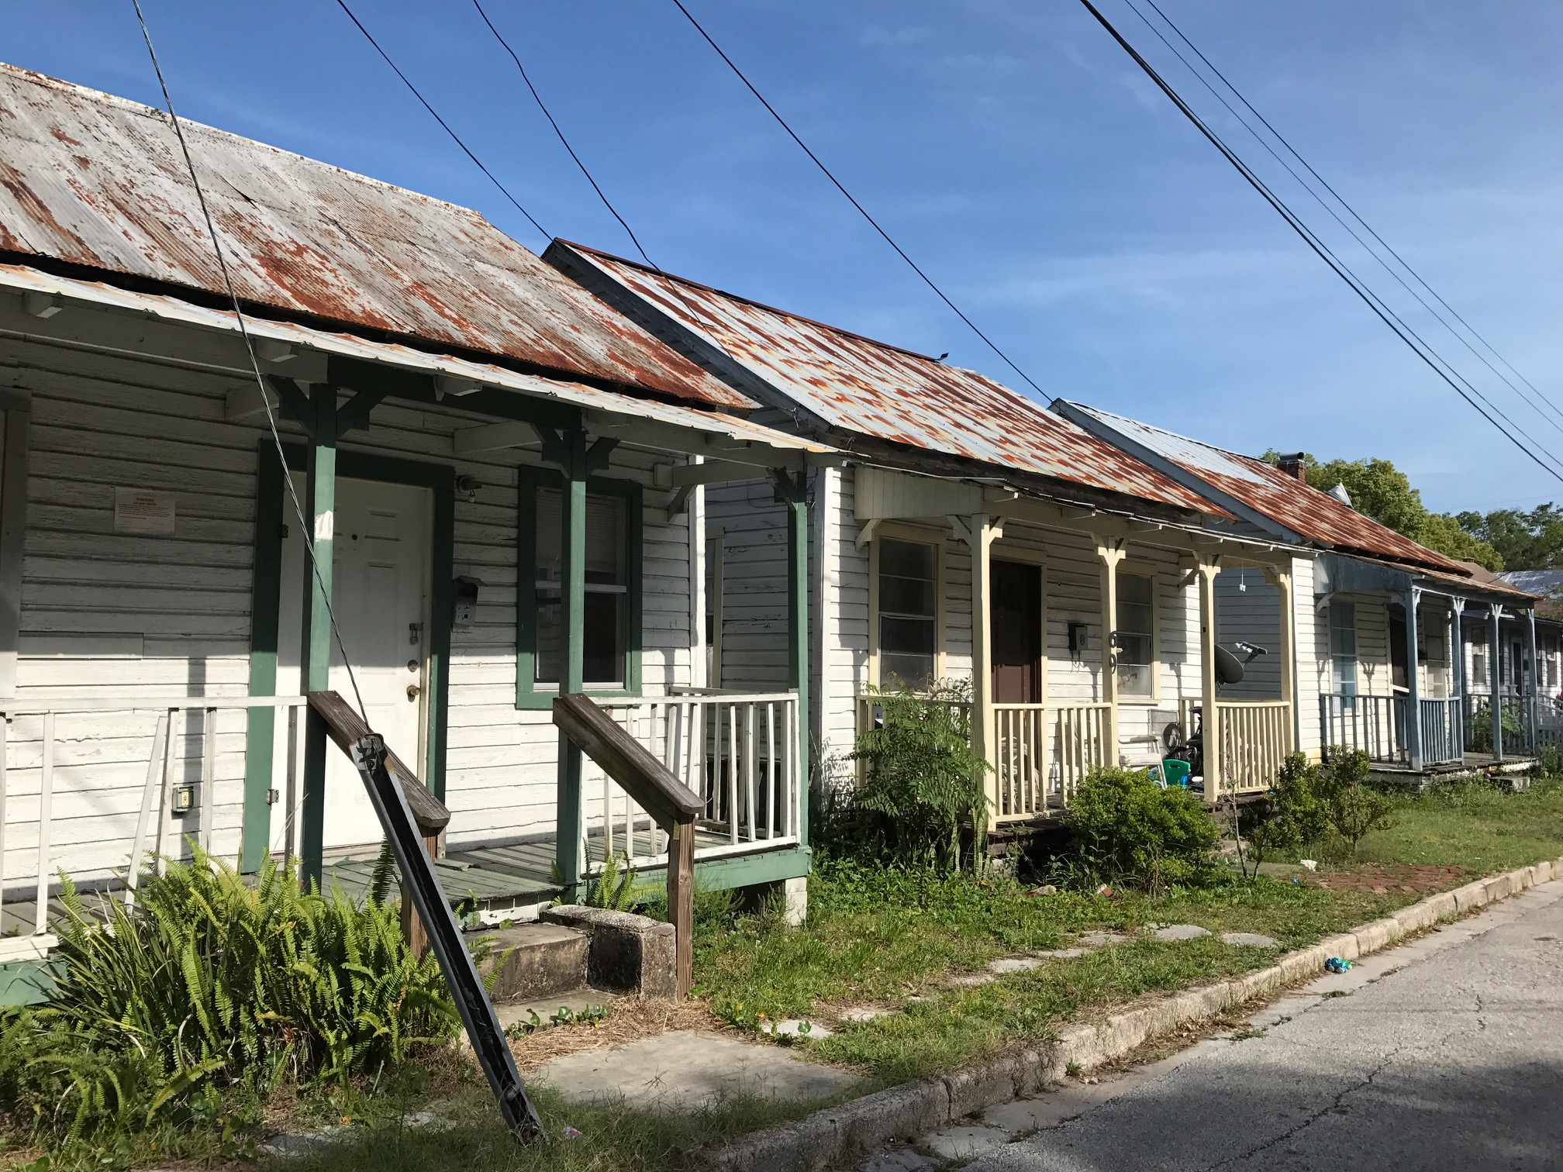
Top Ten Threatened Sites
67-68-69 Osceola Street
Abbot Tract Laborers & Servants Houses
These three identical simple one story Frame Vernacular houses on Osceola were built between 1885-1894 as rental houses for laundresses, cooks, hackmen, firemen, porters, and domestic help in the large homes on Water street, as well as those in the construction trade, including the nearby concrete works. While modest, their distinctive features include jigsawn bargeboards and brackets on their shed porches. They have brick chimneys and are supported by concrete or block piers.
The Abbott Tract, in which they are located, was developed between 1872 and 1930, and includes very large Victorian homes on Water Street, just behind Osceola. These little houses represent a time in the early twentieth century when African-American residences were located in close proximity to the inhabitants’ places of work, particularly within the Abbott Tract.
The buildings are significant not only in terms of age and methods of design and construction, but they also represent an important part of St. Augustine’s African-American history in North City.

Slide 6
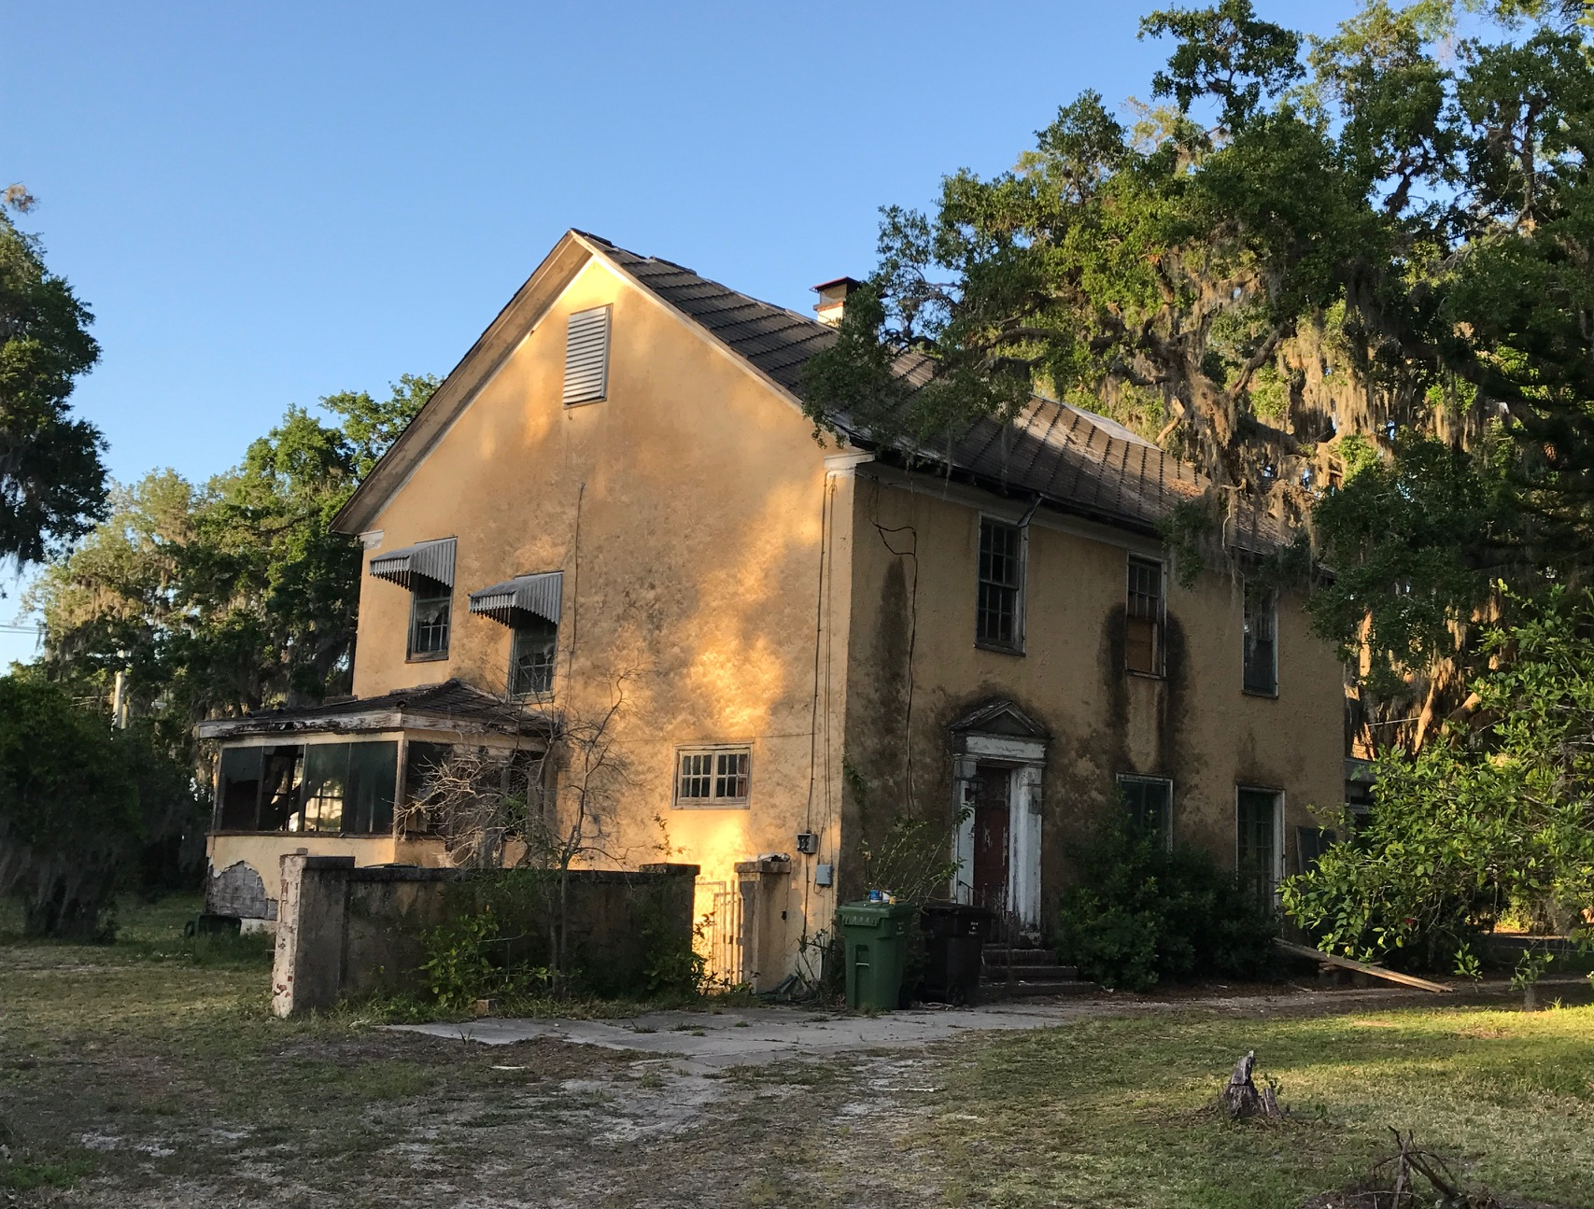
Top Ten Threatened Sites
36 Magnolia Ave
Edson-Buell House
This two story frame vernacular home, built between 1924 and 1930, sits in a prominent location on Magnolia Avenue, across from the Fountain of Youth. It was one of the first houses built in the Miramar Subdivision. With a nod to the Mediterranean style popular in the 1920s, this Frame Vernacular building was given a stucco exterior and stucco chimney. It was built for Horace Edson, a real estate broker during the Florida Land Boom, and later inhabited by I. Van Dillion, General Manager of The Record; Ralph Blaisdell, Chief Account Officer for the FEC; Dr. Herbert E. White, a prominent local physician and surgeon in St. Augustine into the late twentieth century, as well as by several other owners.
The house is presently threatened by extremely poor condition due to neglect. It is listed here because of its state of disrepair, its importance to the character of the neighborhood, as well as its contribution to local history.

Slide 7
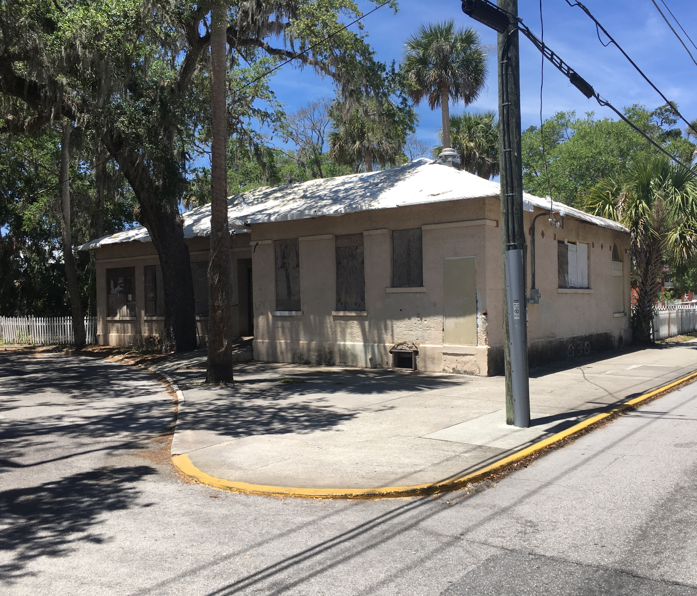
Top Ten Threatened Sites
100 Martin Luther King Blvd
Echo House
The structure known as “Echo House,” as well as “The Lincolnville Community House,” is a portion of a public building complex completed in about 1926. It was originally stucco with a shell dash finish and a barrel tile roof, in the manner of the Mediterranean Revival style. The complex was devoted to the education and welfare of the City’s Black citizens, serving as the original location of the Buckingham Smith Home for the care of indigent African-American citizens, and as a community center. The original plans cited uses as a nursery, for classes and clubs meetings, and as the location of welfare and nurse’s offices. Construction was originally funded by Dr. Andrew Anderson, a prominent community member who died before the buildings were completed.
Two of the original buildings have been demolished and the roof tiles were sold. In 2014, HARB rejected a demolition application for the remaining portion of Echo House with the understanding that it would be renovated, which has not occurred. A second demolition request is pending. Echo House is considered seriously threatened. As an iconic Lincolnville community building with multiple uses over the past ninety years, it deserves preservation.

Slide 8
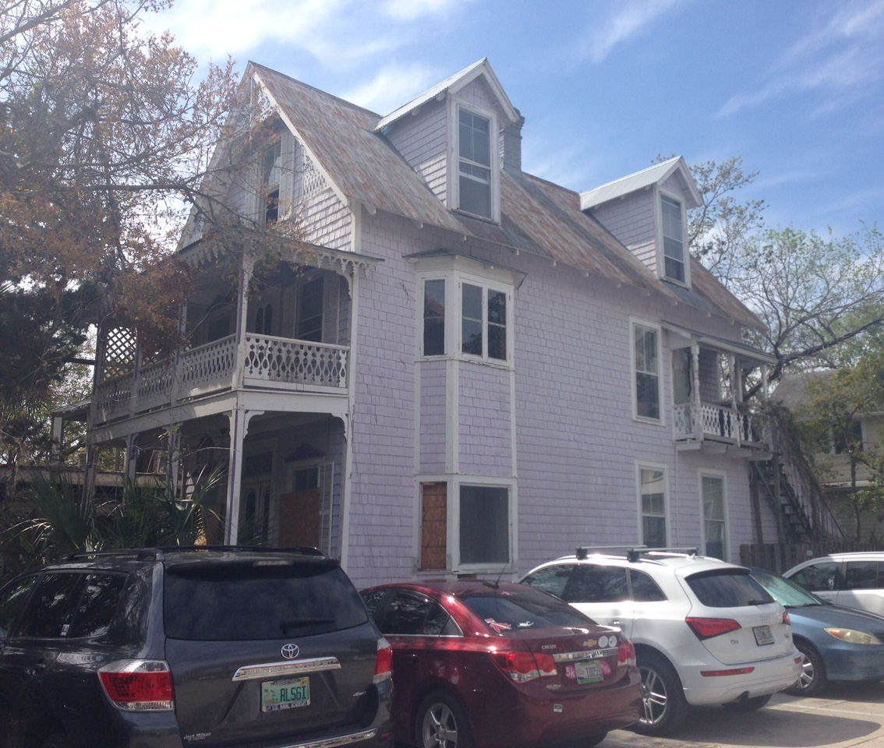
Top Ten Threatened Sites
32 Granada St
Wisteria House
Wisteria House, also known as “Alcazar Cottage,” was constructed in 1893. It has unique construction and architectural attributes of the period and remains largely in original form. Portions of the existing cedar shingle siding may be original. It has been designated a Local Historic Landmark by the City of St. Augustine.
Wisteria House was home to several prominent owners; notably, Antonio Vedovilli a distinguished primitive artist whose work was exhibited in The Peris Gallery in New York. Vedovilli was also featured by Newsweek Magazine in its January 8, 1945 issue. Charles Marston was another distinguished owner. Marston assisted Otto Lightner with accumulating his collection for the Lightner Museum.
The current owner has agreed to restore Wisteria House for commercial use. Plans call for relocating it one lot to the south. Given the risk of moving this old structure, it is on the Threatened List until successfully moved. Loss of Wisteria House would permanently change the character of Granada Street.

Slide 9
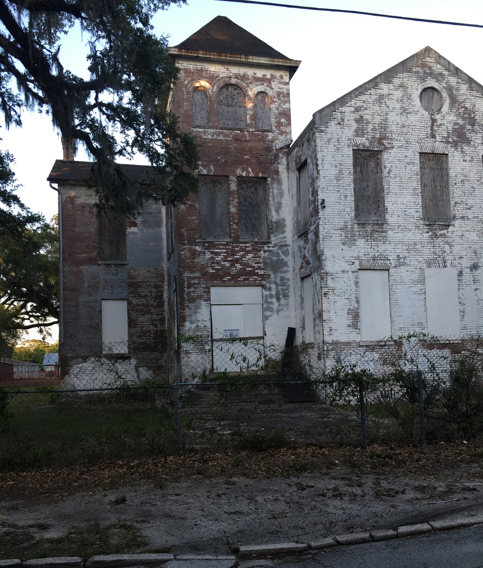
Top Ten Threatened Sites
86 Martin Luther King Blvd
St. Benedict the Moor School
The St. Benedict the Moor Catholic Church, Rectory and School buildings were constructed on land sold by Stella Dumas in 1890. The buildings were constructed in the 1910-1915 timeframe for the Black Catholic Community of Lincolnville. The church building and rectory remain in use today.
The school building, said to be one of the oldest brick buildings in St. Augustine, has been dormant and deteriorating since the 60’s.
The building is iconic within Lincolnville and is considered to hold irreplaceable history to our Black Community. It has been stabilized, but needs further attention to fully preserve it. Restoration costs and funding have prevented activists from proceeding with restoration of the building.

Slide 10
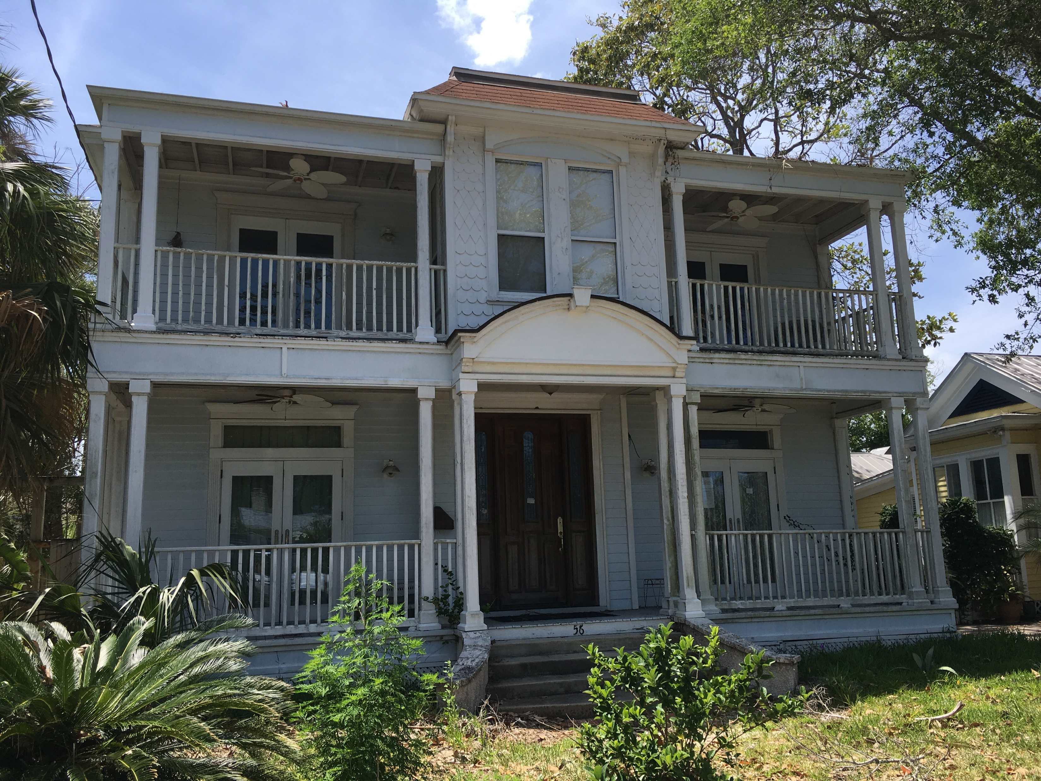
Top Ten Threatened Sites
56 Water St
Alexander-Mullis House
This house is a two story frame vernacular residence constructed in 1872. It is one of nine existing houses in the Abbott Tract known to have been built by Lucy Abbott, one of the first female real estate developers following the Civil War. Despite remodeling through the years, it retains an ambiance and charm that contributes to the historic character of the neighborhood.
Water Street has traditionally been the home of many prominent local residents. Dr. Lawrence Alexander, a physician from Virginia, moved to St. Augustine in 1881 and occupied this house at 56 Water Street sometime after. He maintained an office in a drug store on St. George Street and functioned as proprietor of San Marco Pharmacy and City Drug Store. His wife taught school and served as secretary of the Women’s Exchange. In 1924 Buell O. Pinkham resided in the house, operating a real estate business from his home and serving as city tax assessor. Pinkham was one of three sons of William Slade Macy Pinkham, a councilman, mayor, businessman, yachting enthusiast and hotel proprietor.
This site is on the Threatened List because it went into foreclosure and has not been inhabited for five years.

Slide 11
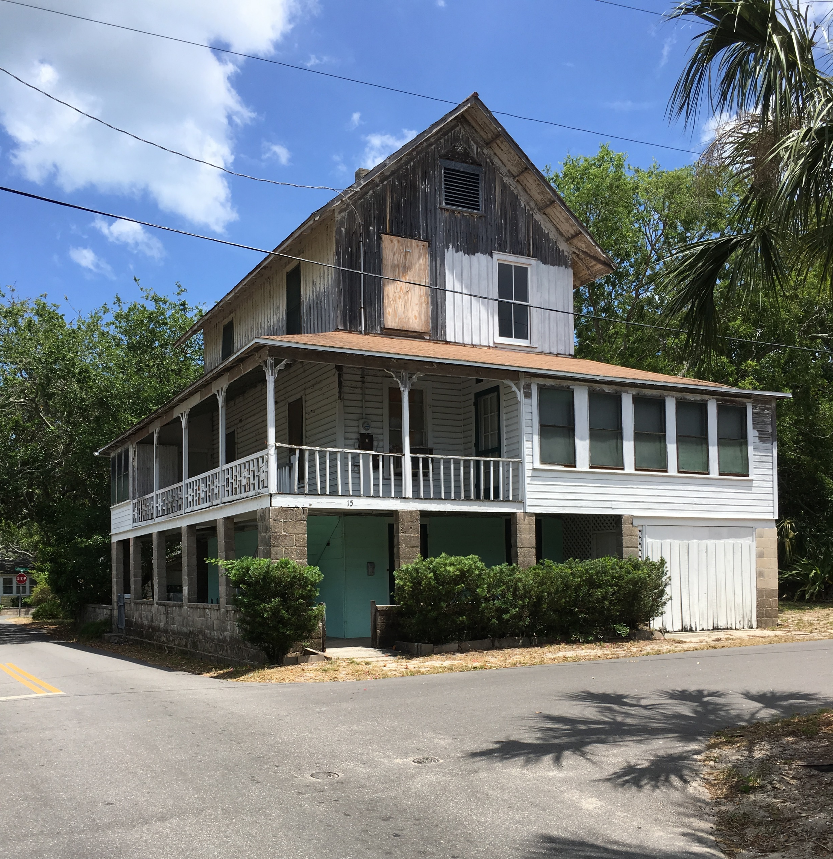
Top Ten Threatened Sites
This 3 1/2 story frame Victorian built in 1890s is one of the distinctive houses in Lighthouse Park. Each story has a different exterior siding: concrete block on first; wood novelty siding on second, and wood board & batten on third. It is one of the few surviving buildings with pioneer board and batten siding in St Augustine and St Johns County and was probably built by U.J. White.
Victorian elements include jigsaw rafters and brackets and a Chinese Chippendale balustrade featuring pierced sections with a quarterfoil pattern. A wrap around porch on four sides was originally open. Interesting owners have been Orange Howes, the postmaster of Anastasia, who earlier operated the skating rink over Maria Sanchez Creek in 1885; Clarence & Florence Bevan, prominent Flagler Era citizens; Martin Hancox, president of Mt Zion Sanctuary Assn of Jersey City; J.D. Rahner, a prominent Flagler Era railroad man; and Sarah White, whose, husband, U.J. White was a prominent developer of both Lighthouse Park and Hastings.
It is threatened by years of neglect, and would be a major loss to the history and character of Lighthouse Park.
15 Ponce de Leon Avenue
Howes-White House

